Slide 1

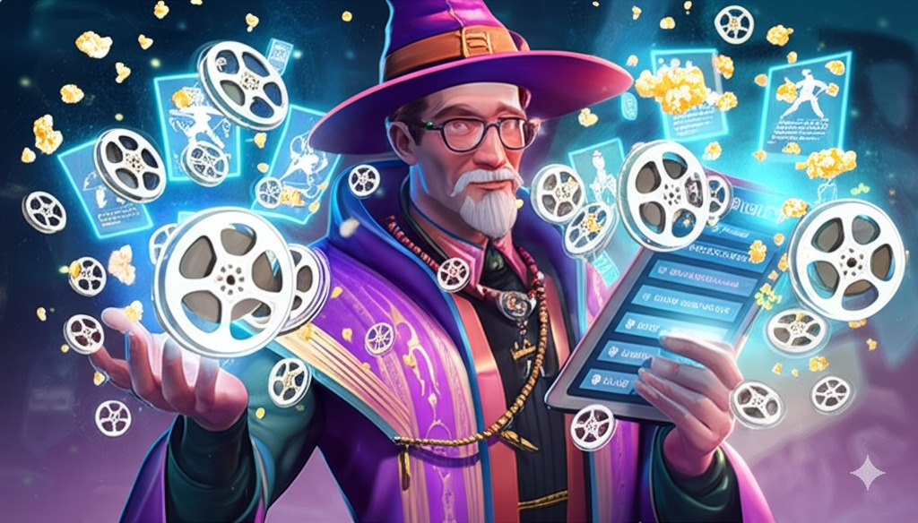
Watchlist Wizard: movie Database Adrian Todd CPSC 3660 Final Project

Slide 2



AGENDA
INTRODUCTION/System Overview
Conceptual and Logical Design
Implementation
SQL Queries Demo
App Demo
Challenges
Future Improvements

Slide 3
Project Goals:
Design a robust and normalized relational database schema for movie data.
Implement the schema using MySQL
Populate the database using data scraped from a real-world source. In this case I used IMDb
Demonstrate effective retrieval and manipulation using various SQL queries
Overarching goal was to gain experience designing and implementing a functional relational database that I could integrate into a web application

Slide 4

System Overview
Web Crawler:
Uses a BFS to scrape movie and people links from IMDb
Built with Python:
Main Libraries used:
mysql-connector-python
Used to connect to and query DB
requests
HTTP library
urllib
BeautifulSoup
Data structure library for representing parsed HTML
Seleneium
WebDriver to control the browser
nltk
Open-source library for Natural Language processing.
MySQL Database:
Implementation of relational schema design
Central Repository storing structured information scraped from IMDb enabling efficient querying for the Backend API
Backend:
Built using Python and the Flask web application framework
Connects to MySQL database
Responds to API endpoint requests
Frontend:
Next.js frontend implemented with React and Typescript
Allows for user interaction

Slide 5
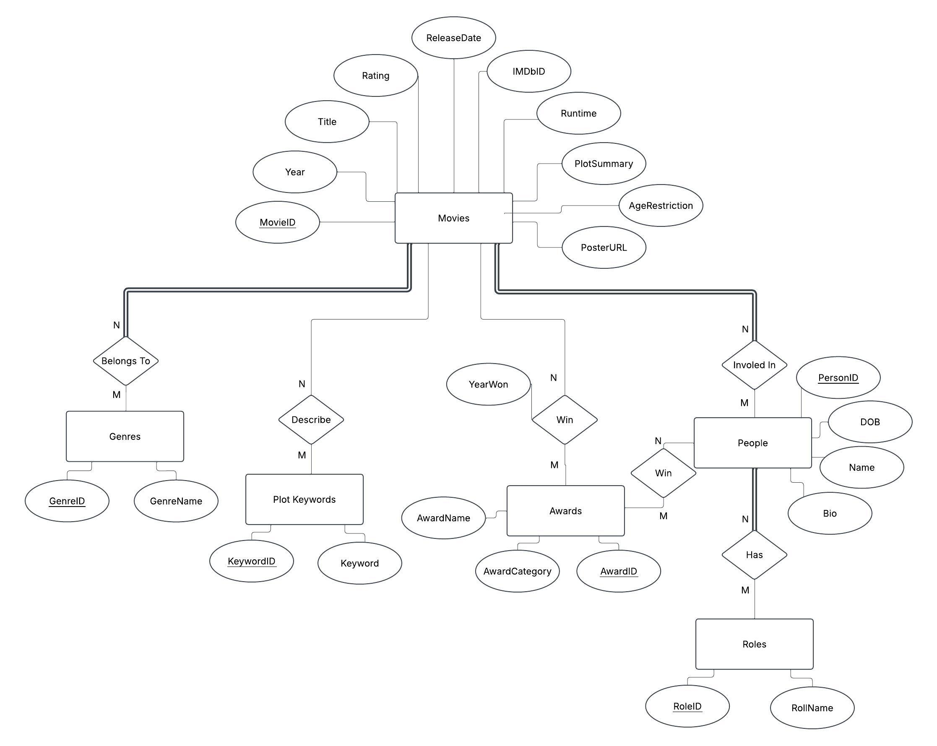

EER Diagram:
Notes:
You can see the main entities: Movies, People (representing actors, directors, crew, etc), Genres, Roles, and PlotKeywords. Some relationships are A Movie can have multiple Genres, and a Genre can apply to many Movies (M:N).
A Movie involves multiple People, and a Person can be involved in many Movies. Furthermore, a Person can have different Roles in different movies (M:N ternary relationship, essentially).
A Movie can be associated with multiple PlotKeywords, and a Keyword can apply to many Movies (M:N). Some constraints were defined like a movie must have people involved and must have a genre(total participation) and specified the ratios (1:N, M:N) on the diagram.“
Some assumptions I made were Source Data Uniqueness & Reliability:
"We assume that the IMDbID provided by IMDb (tt... for movies, nm... for people) serves as a reliable unique identifier from the source for movies and people respectively."
"We assume the combination of a person's IMDbID and Name provides practical uniqueness within our database, acknowledging that IMDb might occasionally reuse IDs over long periods, but this combination mitigates duplicates for active records."
"We assume the core data scraped (titles, years, relationships like actor-in-movie, movie-has-genre) is generally accurate and consistent enough for the primary goal of building a recommendation system."
Scope of Stored Information:
"We assume that the selected attributes (columns) for Movies, People, etc., are sufficient for the core functionality (recommendations, basic display) and that storing every single piece of data available on an IMDb page is unnecessary for this project."
"We assume a predefined, limited set of Roles (Actor, Director, Writer, Producer) captured in the Roles table is adequate for representing the primary contributions we want to track." (You didn't need to capture every crew role).
Relationship Modeling:
"We assume that standard Many-to-Many relationships, resolved through linking tables (MovieGenres, MoviePeople, MovieKeywords), accurately model the connections between movies, genres, people/roles, and keywords."
"We assume that storing the specific role a person had in a movie within the MoviePeople table is the necessary level of detail for this relationship."
Data Integrity Strategy:
"We assume that using ON DELETE CASCADE for foreign keys in linking tables is the desired behavior. This means if a core entity (like a Movie or Person) is deleted, its associations in MovieGenres, MoviePeople, etc., are automatically removed, ensuring referential integrity without leaving orphaned records." (Alternatively, state if you chose a different strategy like ON DELETE SET NULL or no action).
"We assume that explicit database triggers are not necessary for maintaining basic data consistency for this project's scope, relying instead on Primary Keys, Foreign Keys, and UNIQUE constraints."
Keyword Representation:
"We assume that extracting keywords based on frequency analysis from plot summaries (using NLTK) provides a reasonable, though basic, representation of a movie's themes for filtering and potential recommendations."
Focus on Movies:
"We assume the initial design focus is on movies. While the schema could potentially be adapted, TV shows or other media types might require modifications or additional tables not included in this iteration."

Slide 6
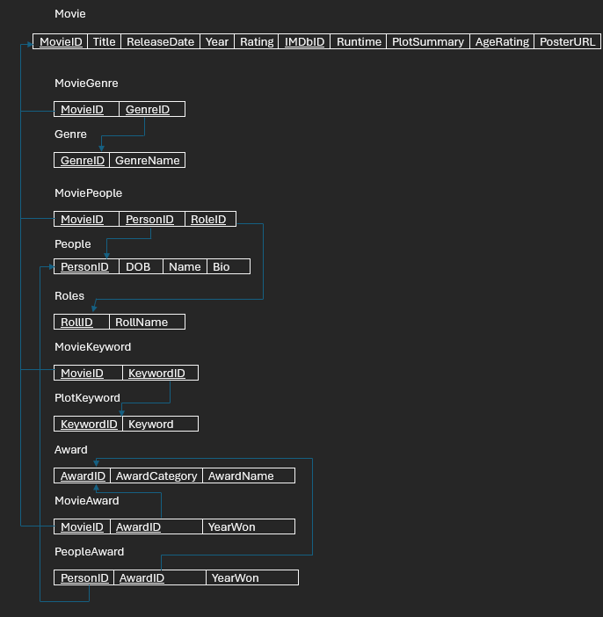
Notes:
I then translated the EERD into a logical Relational Model, implemented in MySQL. Let's look at the key tables: Movies Table:
This is the central table, holding core information about each film.
PK: MovieID (an auto-incrementing integer uniquely identifying each movie record).
Key Columns: Contains Title, Year, Runtime (stored as integer minutes), Rating (decimal), PlotSummary, PosterURL, ReleaseDate, and AgeRating.
UNIQUE Constraint: We added a UNIQUE constraint on IMDbID to prevent duplicate entries for the same movie from our data source.
People Table:
"This table stores information about individuals – actors, directors, writers."
"PK: PersonID (auto-incrementing integer)."
"Key Columns: Includes Name, BirthDate, Bio, and the person's IMDbID."
"UNIQUE Constraint: A composite UNIQUE constraint on (IMDbID, Name) ensures data integrity, as occasionally IMDb might reuse IDs, but the ID/Name pair should be unique.“
Lookup Tables: Genres, Roles, PlotKeywords:
These tables act as controlled vocabularies to ensure consistency and normalization.
Genres stores unique genre names (GenreName is UNIQUE) with a GenreID (PK).
Roles stores unique role names (RoleName is UNIQUE, e.g., 'Actor', 'Director') with RoleID (PK).
PlotKeywords stores unique keywords (Keyword is UNIQUE) with KeywordID (PK).
Using these lookup tables prevents us from storing redundant text strings directly in the Movies or People tables.“
Linking Tables: MovieGenres, MoviePeople, MovieKeywords:
These three tables are crucial – they implement the Many-to-Many (M:N) relationships from our EERD.
MovieGenres connects Movies and Genres. Its PK is (MovieID, GenreID), preventing duplicate genre assignments for the same movie.
FKs: MovieID references Movies(MovieID), and GenreID references Genres(GenreID).
MoviePeople connects Movies, People, and Roles. Its PK is (MovieID, PersonID, RoleID), defining a unique role for a person in a specific movie.
FKs: References Movies(MovieID), People(PersonID), and Roles(RoleID).
MovieKeywords connects Movies and PlotKeywords. Its PK is (MovieID, KeywordID)."
"FKs: References Movies(MovieID) and PlotKeywords(KeywordID)."
Referential Integrity & ON DELETE CASCADE: "All Foreign Keys in these linking tables are set up with ON DELETE CASCADE. This is an important decision. It means if a record in a parent table (like a specific Movie or Person) is deleted, the corresponding rows in these linking tables are automatically removed. This prevents orphaned records and maintains data consistency without needing manual cleanup or triggers for these specific cases."

Slide 7
SQL Queries Demo

Slide 8
Web App Demo

Slide 9
Challenges & Future Improvements
Web Scraping Data:
Initial sleuthing through IMDb’s HTML to find the right elements and classes containing the data I wanted to extract.
Handling Dynamically loaded content.
Learning about the limits placed on web scraping. robots.txt and adding delays to limit how fast my web scraper was submitting requests.
Structure of Movie Awards on IMDb:
So many different types of awards so the data was going to be to time consuming to parse and scrape.
Implement User accounts and a recommendation algorithm:
Add user accounts system so they can keep track of watched movies, create a watchlist, and rate movies they have watched.
Add TV Show Data
Expand the depth of web crawling.

Slide 10

Conclusion
Successfully designed and implemented a relational database for movie data.
Demonstrated ability to populate the database via web scraping.
Effectively utitlized various SQL queries to retrieve and manipulate data.
The robust database provides a solid foundation for further building out this application.
And.. That’s a wrap for this presentation.

